Slide 1
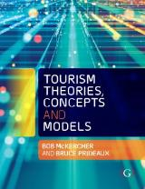

Chapter 3: The Structure of Tourism

Slide 2
Learning Objectives
Describe the key elements of systems models
Compare and contrast different open and closed ended models of tourism
Demonstrate how each of us operates within our own unique tourism system
Analyse the concept of a destination as a key component of any model
Discuss how space change can lead to adverse impacts of tourism

Slide 3
Tourism as a system
A system is defined as a set of elements standing in interrelation among themselves and their environments
To be complete, a system must possess:
  An environment – the system’s location;
  Units – the system’s parts;
  Relationships – how the parts interact;
  Attributes – the quality of the units in the system itself;
  Inputs, outputs and feedback; and
  A model.
Tourism functions as a system, where the parts contribute to the whole, but the whole is far greater than the sum of its parts

Slide 4
Tourism is an adaptive complex system
Traditionally, a reductionist approach is taken, whereby the system is broken down into its component parts and each is examined individually.
But does not explain how the system functions as a holistic whole.
Leiper (2004) notes many models had become nothing more than a set of elements that came into play when people went on trips.
Today, tourism is recognised as an adaptive, open complex system guided by the rules of complexity theory.
  The reason is that complex systems do not have predictable reactions, cannot be decomposed, have nonlinear interactions, high sensitivity to initial conditions, are dynamic, adaptable to the environment, produce emergent structures and behaviours, and can become chaotic.
More in Chapter 9

Slide 5
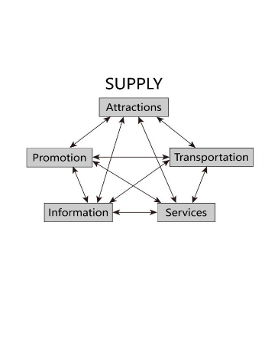
Gunn’s Functioning Tourism System
Two main drivers of tourism consist of a demand and supply side
Demand side has 4 elements: motivation, finances, time, and physical ability to travel
Supply side corresponds closely to the 5 A’s of tourism
Plus externalities, that include government policy, community attitudes, natural and cultural resources, leadership and the role of competition

Slide 6
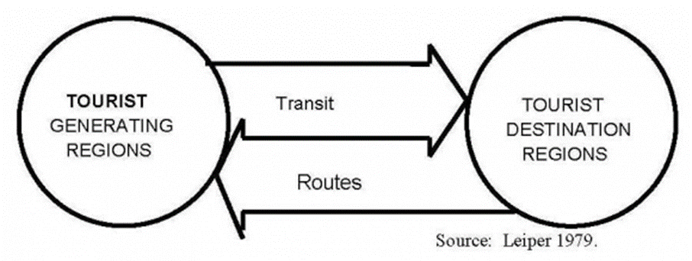
Leiper’s(1979) geographic tourism system
Tourism systems comprise 3 elements:
  Tourist generating region - includes the basic geographic features as well as the social push elements that drive people to travel.
  The tourist destination areas - physical space, and also encompass those attributes that appeal to tourists and may pull them there.
  The transit region representing the space tourists must pass through or over to get to the destination and return home again.

Slide 7
Leiper’s (1982) systematic model for interdisciplinary tourism studies
Each side of the pentagon represents one element in a whole tourism system.
Lines inside the pentagon represent the process: studying any one element involves considering its links with the other four.
Research about tourism must recognize, implicitly or explicitly, connections between elements and between a system and its environments.

Slide 8
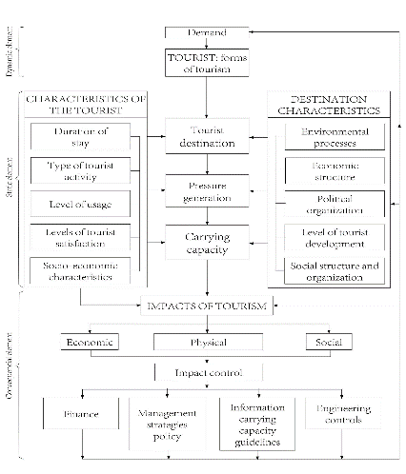
Mathieson and Wall (1982) model
Open tourism system with 3 elements
  The first is a basic dynamic element that involves the decision to travel and the range of social, economic and institutional factors that affect these decisions.
  The second is the static or destination element, where the stay in the destination interacts with its economic, environmental and social systems.
  The third element is the outcome of the system or a consequential element, which includes the social, environmental and economic systems tourism come in contact with, directly or indirectly.

Slide 9
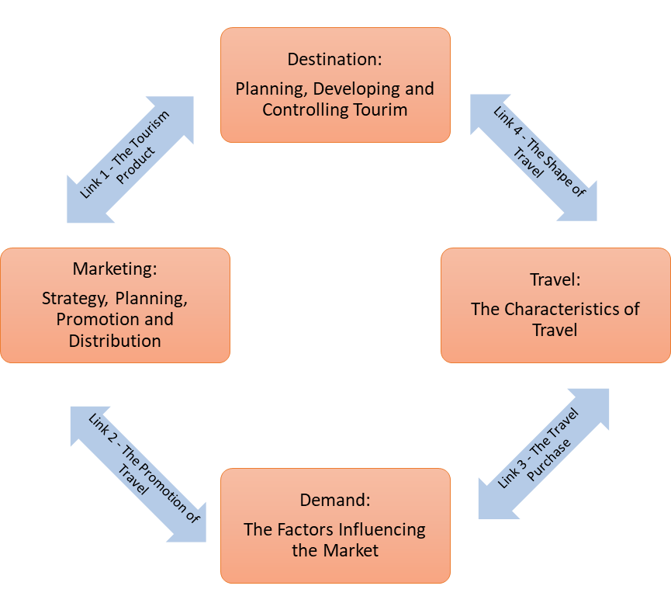
Mill and Morrison’s (1985) marketing model
4 interlinked components
  Market or Demand – market inputs of tourism suppliers, and the process by which a buying decision is reached
  Marketing – process by which the destination area and individual suppliers market their products and services to potential customers
  Destination – where tourism activity occurs
  Travel – linking the tourist to the destination

Slide 10
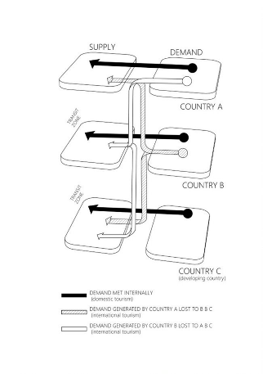
Thurot (1980)
Every place can be:
  a generating region,
  a main or secondary destination, and
  a transit zone in its own right.
Different elements of the commercial tourism sector perform unique functions depending on the role the place plays

Slide 11
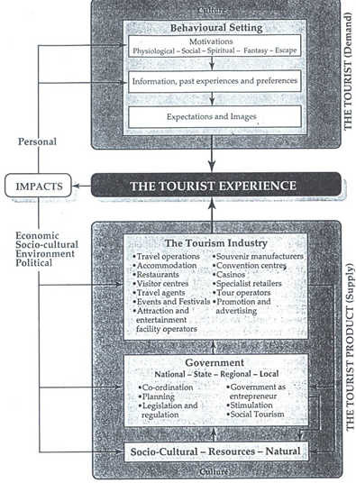
Hall (1985)
Adopts an open systems approach
Demand side influenced by a combination of factors
Supply side relates to the range of tourism resources available, government’s role and the tourism industry.
Supply and demand provide the basis for the tourism experience and the likely outcomes or impacts of tourism.
  How well these two match and how well tourism is managed will influence the range of positive and negative impacts felt.

Slide 12
Each tourist operates within his/her own tourism system
Activity/Attraction | Number of people participating | Number of different activity sets | % of different sets
Beaches | 221 | 216 | 97.7
Religious sites | 298 | 285 | 95.6
Natural areas | 270 | 259 | 97.7
Historical attractions | 315 | 299 | 94.9
Museums & art galleries | 246 | 235 | 95.5
Shopping | 1107 | 850 | 76.8
Sightseeing | 865 | 727 | 84.0
Theme parks | 383 | 346 | 89.4
All | 1304 | 1002 | 76.8
We tend to talk about a tourism system as a collective whole
BUT, since the system begins and ends with the tourist, then each person will operate within his or her own tourism system.
Each system will overlap at many points along the way, but each is discrete. Overlap can occur when we share the same flight, stay at the same hotel or visit the same attraction.
Source: McKercher 2004

Slide 13
Destinations consist of 3 types of place
‘Tourism place’ is designated for the primary use of tourists. Locals are welcome and can behave as tourists
‘Shared place’ is hybrid place where both tourists and locals are welcome, providing tourists adhere to certain norms of social behaviour
‘Non-tourism place’ represents areas where tourists are not supposed to visit. They constitute most of the destination
  May be transited through to reach share and tourism space

